Slide 1
Topic 1: Algorithm Analysis

Slide 2
Performance of Algorithms
 | Empirically | Analytically
How | Execute the implementation multiple times | Analyzing the data flow of the algorithm/pseudocode
Pros | Representative of real world performance Useful when algorithm is not available | Independent of implementation details, programming language, machine, etc. Asymptotically true
Cons | Requires time to test Results dependent on implementation details, programming language, machine, etc. | Does not take into account I/O or memory operations Not always reflective of practical settings (such as large constants)
What are methods to compare algorithms ? How do we measure them ?

Slide 3
General Rules for Computing Performance
Rule 1 Consecutive Statements
Add the time of each statement
Rule 2 Loops
The running time of the statements inside the loop times number of iterations
Rule 3 Nested Loops
Analyze from the inner most loop
The total running time inside a group of nested loops is the product of time per loop
Rule 4 If/Else
Take the section with the larger time

Slide 4
Examples
for ( int i = 0; i < n; i ++) for ( int j = 0; j < n; j ++) sum++;
for ( int i = 0; i < n; i ++) for ( int j = 0; j < n*n; j ++) sum ++;
for ( int i = 0; i < n; i ++) for ( int j = 0; j < i; j ++) sum++;
for ( int i = 0; i < n; i ++) for ( int j = 0; j < i; j ++) for (int k = 0; k < j; k++) sum++;
If(n <=1)
return 1
Else
return n*fact(n-1)

Slide 5
Asymptotic Computational Complexity
When computing the complexity analytically, we should factor out the effect of implementation details
We assume if the size of the problem is large enough, then the variation in time due to the implementation details can be folded into constants
C₁f₁(n)+C₂f₂(n)+….+C_{x}f_{x}(n)
As the value of n increases n->∝, the higher value function dominates, i.e. n² grows faster than n
Asymptotic means going to very high values
Thus when computing the complexity asymptotically, we can ignore the constants and the lower valued functions

Slide 6
Computational Complexity
T(N) time to execute a program with input of size N
 | Big O (Upper Bound) | Omega (Lower Bound) | Theta (Upper and Lower Bound)
Definition (remember this) | T(N)=O(f(n)) if there are positive constants c and n0 such that T(N)≤cf(N), when N≥n0 | T(N)=Ω(g(n)) if there are positive constants c and n0 such that T(N)≥cg(N), when N≥n0 | T(N)=Θ (h(n)) if and only if T(N)=O(h(n)) and T(N)=Ω (h(n)), when N≥n0
Meaning (understand this) | The time taken by the program will be no more than a constant C times f(n) for all input sizes larger or equal to n0. | The time taken by the program will be no less than a constant C times g(n) for all input sizes larger or equal to n0. | The time taken by the program will be no more than a constant C1 times h(n) and no less than a constant C2 times h(n) for all input sizes larger or equal to n0.

Slide 7
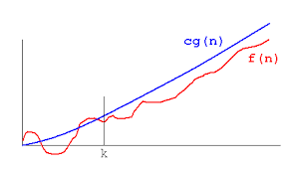
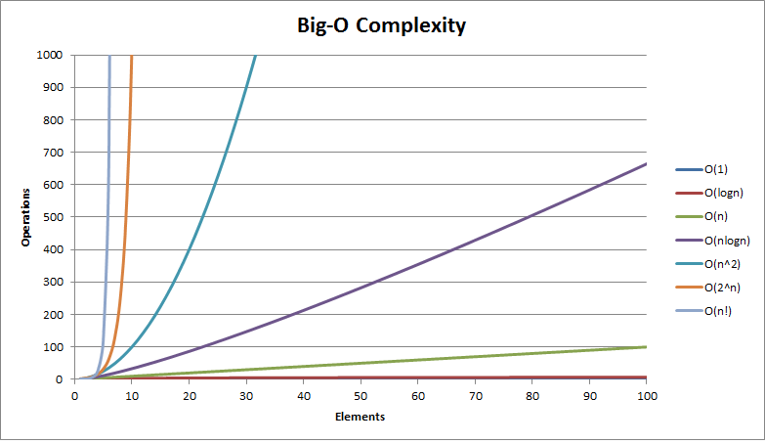
Actual time f(n)
Big O complexity O(g(n))
Image from quora.com
Big-O complexity of different functions
Image from bigocheatsheet.com
Common Functions used for Complexity
C constant
Log(n) logarithmic
N linear
N log(N)
N^{k} polynomial (k=2 Quadratic, k=3 Cubic)
C^{N} Exponential

Slide 8
Computing Complexity in Big-Oh
Given the function of the running time it is generally easy to determine the Big Oh function
How do we determine the n0 (initial point) and c (constant)
n0 ≥ 0 (nonnegative integer)
c≥ 1 (positive integer)
By appropriate algebraic manipulation show that if n ≥ n0 then T(n)≤ cf(n) for the n0 and c selected

Slide 9
Example
Let T(n)=(n+1)²
T(n)=n²+2n+1
Rule of thumb: Add the constants to get c. Set n0 to the constant of n⁰
Here n0=1and c=4 we can state that T(n)=O(n²)
Other c and n0 can also apply
Lower n0 allows us to start from a lower cut-off
Higher C allows for a larger envelope
How about n0=3and c=2 ?
How about selecting n0=0?
We can use induction to prove these statements

Slide 10
Proof by Induction
To show the statement is true for all n≥k
Basis Case: Show that the statement is true for the base value of k.
Inductive Hypothesis: Assume that the statement S(n) will be true for all consecutive n ≤k
Inductive Step: Show that if the statement is true for n then it is true for n+1; S(n)=> S(n+1)

Slide 11
Examples
Prove that summation of the powers of 2 from 0 to n is 2^{n+1}-1 for n≥0
For any positive integer n, 6^n-1 is divisible by 5
Given that r²=r+1. Show that F(i) ≥ r ^{n-2,} where F(i) is the i^{th} element in the Fibonacci sequence given in the previous slide

Slide 12
Find the Complexity
T1(n)=5n+6n²
T2(n)=4nlog(n)+5(n)
T3(n)=T1(n)+T2(n)
T4(n)=n⁴+n²+1
T5(n)=2^{n}
What are the n0 and c terms for each case ?

Slide 13
Bounds that are NOT Asymptotically Tight
Asymptotically tight bounds is the best function that can fit
For T(n)=n2+2n+1; O(n3) is an upper bound, as is O(n2)
However, O(n2) is the more close fit so it is asymptotically tight
O(n3) is NOT asymptotically tight
Not asymptotically tight upper bound (small o)
Note use of any positive constant as opposed to there exists a positive constant
T(n)=o (g(n)): for any positive constants c>0 such that 0≤T(n)< cg(n), when n≥n0
T(n) becomes insignificant relative to g(n) as n approaches infinity
T(n)=ω (g(n)): for any positive constants c>0 such that 0 ≤cg(n)< T(n), when n≥n0
T(n) becomes arbitrarily large relative to g(n) as n approaches infinity

Slide 14
Recursive Functions
Time for recursive functions can be written using a recurrence relation.
Recall for the factorial
Constant time for multiplication plus time for factorial of n-1
T(n)=C+T(n-1)

Slide 15
Solving Recursive Functions
To compute the complexity for recursive functions
T(n)=aT(n/b)+f(n)
Methods
Iterative Method ( Expand the form and express it as a summation of terms) –use recursion trees
Master’s Theorem—cookbook method
Solve T(n)=3T(n/4)+Cn²

Slide 16
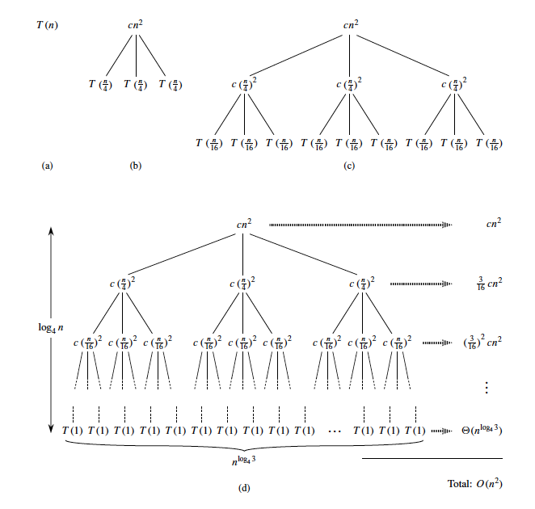

Slide 17
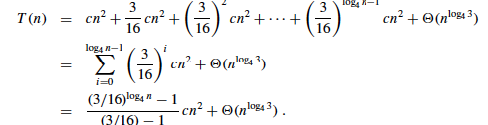
Iteration Method Example
T(n)=3T(n/4)+cn²

Slide 18
Master’s Theorem
T(n)=aT(n/b)+f(n) a >0; b>1
Case1: If f(n)is O(n^{log}_{b}^{a-ε}); where ε>0 then T(n) is θ(n^{log}_{b}ª).
If f(n) is smaller O(n^{log}_{b}ª) then T(n)= θ(n^{log}_{b}ª).
Example: T(n)=2T(n/2)+1
Case 2: If f(n)is O(n^{log}_{b}ª); then T(n) is θ(n^{log}_{b}ª lgn).
If f(n) is equal to O(n^{log}_{b}ª) then T(n)= θ(n^{log}_{b}ª lg_{b}n).
Example: T(n)=2T(n/2)+n
General Case: f(n)is O(n^{log}_{b}ª (lg_{b}n)^{p}); p>-1 T(n)= O(n^{log}_{b}ª (lg_{b}n)^{p+1});
f(n)is O(n^{log}_{b}ª (lg_{b}n)^{p}); p==-1 T(n)= O(n^{log}_{b}ª (lg_{b}lg_{b}n));
Case 3: If f(n)is Ω(n^{log}_{b}^{a+ε}); where ε>0 and if af(n/b)≤ cf(n) for c <1and sufficiently large n (regularity condition) then T(n) is θ(f(n))
If f(n) is greater than O(n^{log}_{b}ª) AND f(n) grows faster than af(n/b) then T(n) is θ(f(n))
Example: T(n)=2T(n/2)+n²

Slide 19
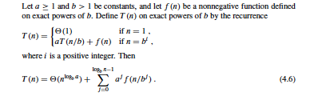
Proof of Master Theorem
We will only prove when n is an exact power of b

Slide 20
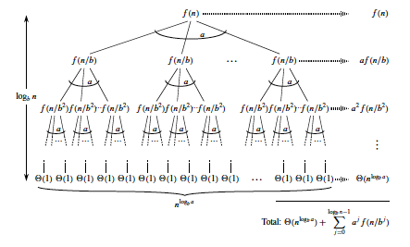

Slide 21
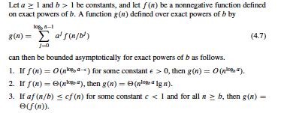
Proof of Master Theorem, Continued

Slide 22
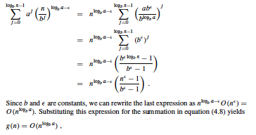
Case 1

Slide 23
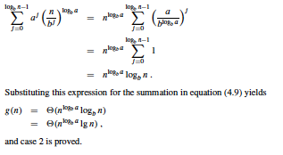
Case 2

Slide 24
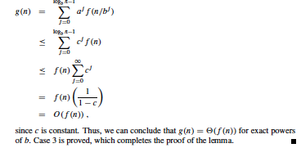
Case 3
Given af(n/b) ≤ cf(n), for some c <1 and n≥ b

Slide 25
Extension for Case 2
f(n)is O(n^{log}_{b}ª (lg_{b}n)^{p});
(i) p>-1 T(n)= O(n^{log}_{b}ª (lg_{b}n)^{p+1});
(ii) p==-1 T(n)= O(n^{log}_{b}ª (lg_{b}lg_{b}n));
(iii) p<-1 T(n)= O(n^{log}_{b}ª );

Slide 26
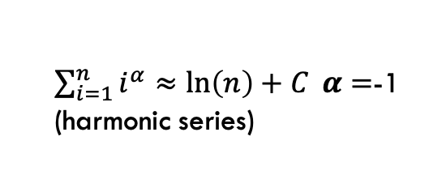
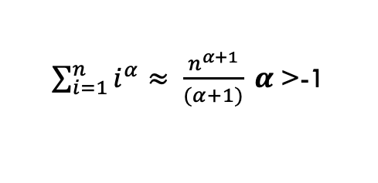
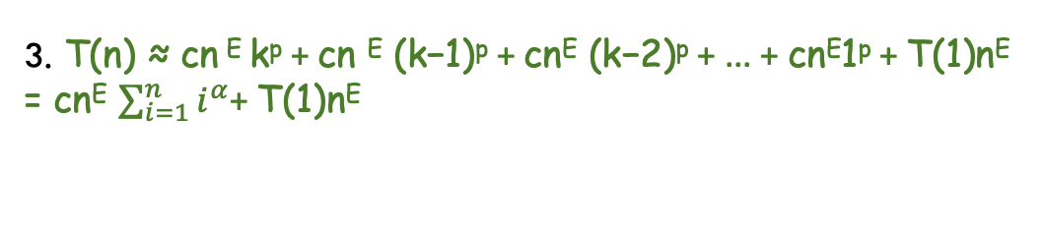
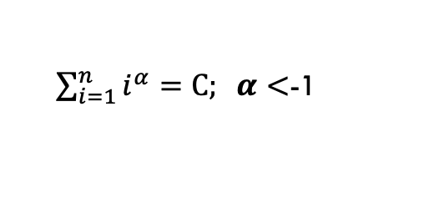
Proofs for Extension
1. T(n)=aT(n/b)+f(n)
T(n) = f (n) + af (n/b) + a²f (n/b² ) + ... + a ^{(k−1)}f (n/b^{(k−1)} ) + a^{k} T(1).
f(n)=O(n^{log}_{b}ª (lg_{b}n)^{p})= cn^{E} (lg_{b}n)^{p}; E= ^{log}_{b}ª
2. T(n) ≈ cn^{E}(log_{b}n)^{p} + ac(n/b)^{E} (log_{b}(n/b))^{p}+ a²c(n/b² )^{E}(log_{b}(n/b² ))^{p} + ...+ a^{k}T(1)
n = b^{k}, => log_{b}(n/b^{i}) = log_{b}b ^{(k−i)} = k-i a^{k}=n^{E.} a=b^{E.} a^{i} / b^{iE} = 1
3. T(n) ≈ cn ^{E} k^{p} + cn ^{E} (k−1)^{p} + cn^{E} (k−2)^{p} + ... + cn^{E}1^{p} + T(1)n^{E} = cn^{E} $\sum_{i=1}^{n}{i^{α}}$+ T(1)n^{E}
$\sum_{i=1}^{n}{i^{α}≈ \frac{n^{α+1}}{(α+1)}} α$>-1
$\sum_{i=1}^{n}{i^{α}≈\ln\left(n\right)+C} α=$-1 (harmonic series)
$\sum_{i=1}^{n}{i^{α}}=C; α<$-1

Slide 27
Master’s Theorem Cannot Be Applied When…
Recursion Relation: T(n)=aT(n/b)+f(n)
a is not a constant
T(n)=2^{n}T(n/2)+n²
a<1
T(n)=.5T(n/2)+n²
f(n)> n^{log}_{b}ª but regularity condition not violated; there is no c< 1 for which af(n/b)<cf(n)
T(n)=T(n/2)+n(2-cosn)
f(n) is not positive
T(n)=2T(n/2)-n²

Slide 28
Examples
T(n)=3T(n/2)+n²
T(n)=4T(n/2)+n²
T(n)=T(n/2)+2^{n√√}
T(n)=16T(n/4)+n
T(n)=2T(n/2)+nlogn
T(n)=3T(n/3)+√n
T(n)=2T(n/2)+n/logn

Slide 29
Why Parallel Programming
Faster and Larger Computations
Solve computing-intensive problems faster
Solve larger problems in same amount of time
Reduce design time
Improve solution precision
Many divide and conquer problems can be expressed as parallel programs

Slide 30
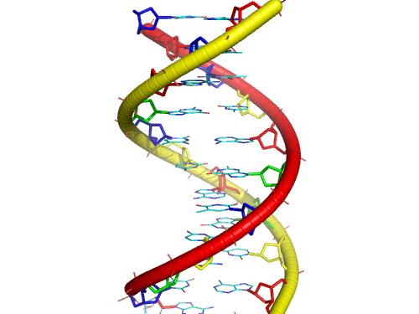




Parallel Computing
Using many computers all together to solve large problems, faster

Slide 31
EXAMPLE
Find n!
Divide the numbers into k processors
Compute sequential products on elements in each processor
Multiply the results from each processor
3*4
5*6
7*8
1*2
5*..*8
1*..*4
8!

Slide 32
Execution Time Components
Inherently sequential computations: σ(n)
Potentially parallel computations: ϕ(n)
Communication operations: κ(n,p)
Parallel on
P processors
Potentially
parallel
Extra time for communication
Inherently Sequential
Inherently Sequential

Slide 33
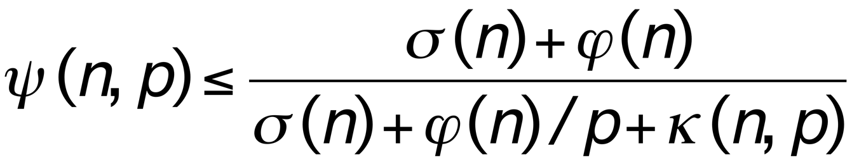
Speedup Expression

Slide 34
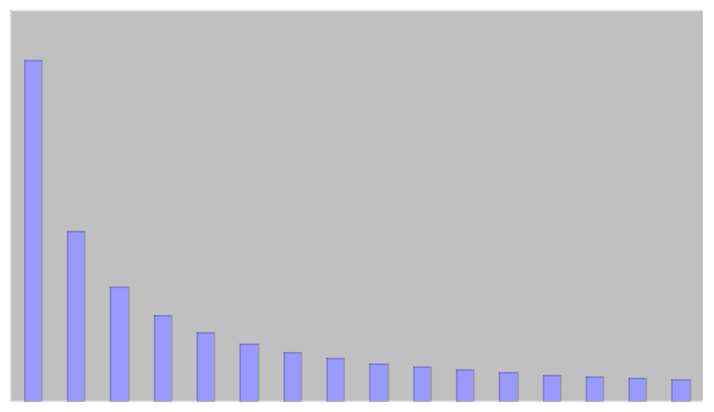
ϕ(n)/p

Slide 35
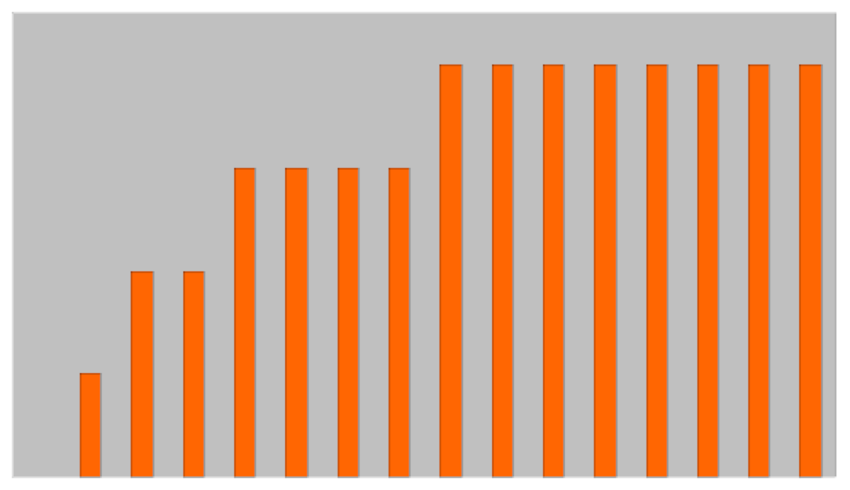
κ(n,p)

Slide 36
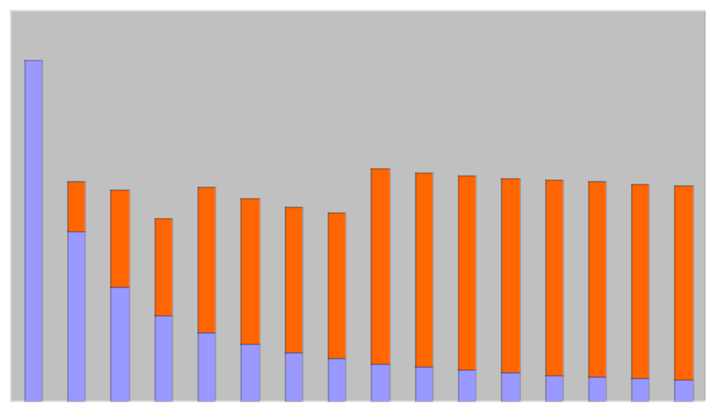
ϕ(n)/p + κ(n,p)

Slide 37

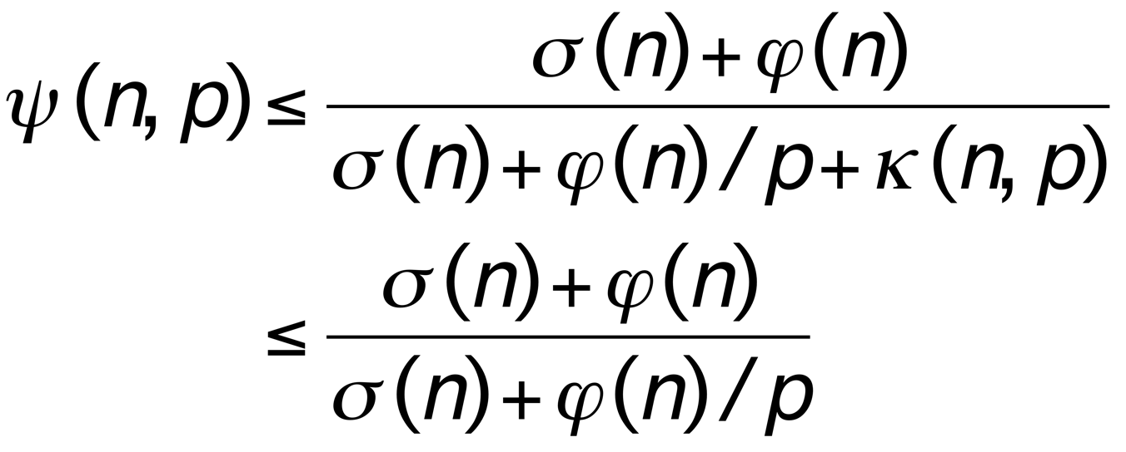
Amdahl’s Law
Let f = σ(n)/(σ(n) + ϕ(n))
Percentage of sequential time
Let f be the fraction of operations that must be performed sequentially. The maximum speedup achievable by a parallel computer with p processors is given by

Slide 38
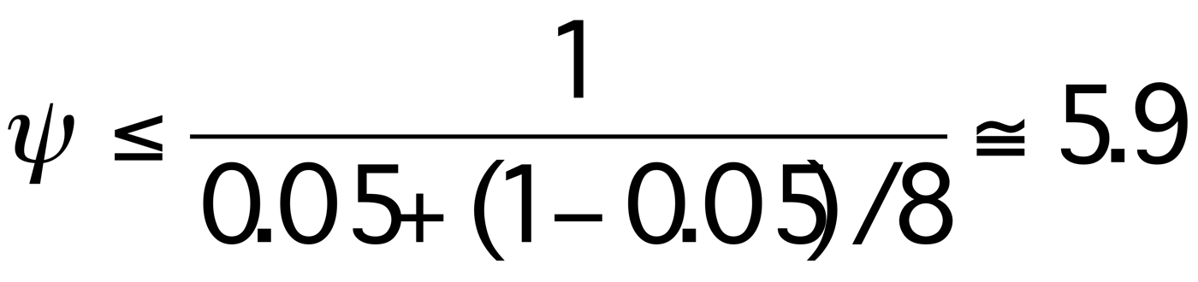
Example 1
95% of a program’s execution time occurs inside a loop that can be executed in parallel. What is the maximum speedup we should expect from a parallel version of the program executing on 8 CPUs?

Slide 39
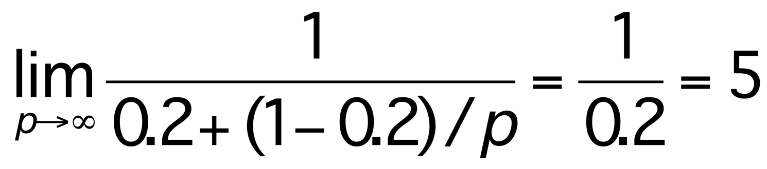
Example 2
20% of a program’s execution time is spent within inherently sequential code. What is the limit to the speedup achievable by a parallel version of the program?

Slide 40
Complexity and SPEEDUP
A parallel program of size n can run in x seconds. If the speed of the computer is made 4 times faster, what is the size of the program that can run in the same time (x seconds) in the new machine. Given the complexities of the algorithms are;
𝛳(n⁴)
𝛳(n²)
𝛳(n)
𝛳(nlogn)

Slide 41
Next Class
Data Structures
Balanced Binary Trees (recap)
B-Trees
Splay tree
Heaps, Priority Queues (recap)
Bloom Filters
Hashing

